Slide 1
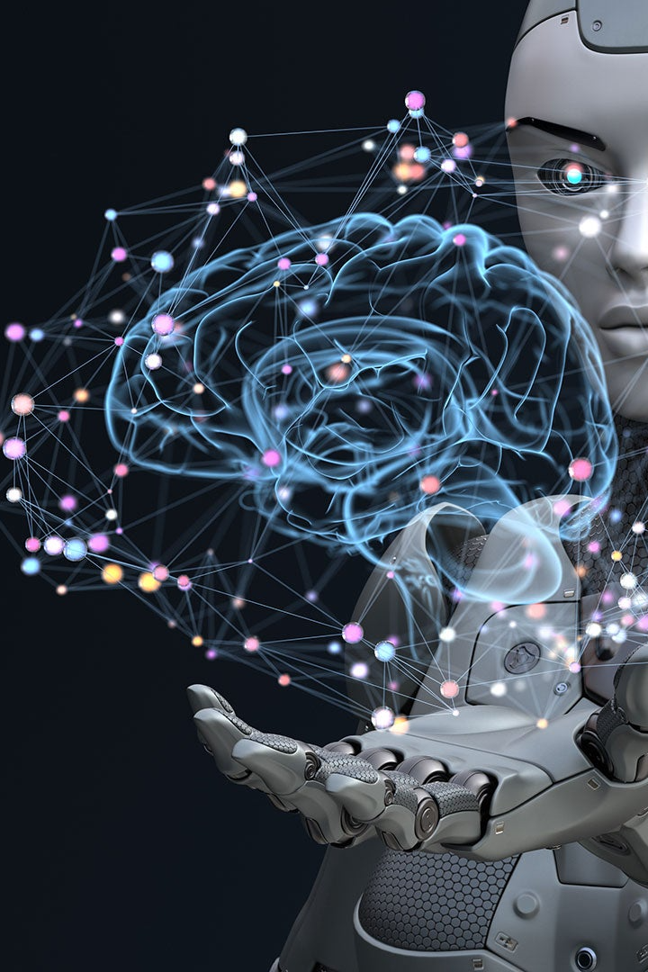
Introduction to Artificial Intelligence
Welcome to the exciting world of Artificial Intelligence! Discover the wonders of AI, explore its various types, approaches and applications, and learn about the ethical considerations and future of AI

Slide 2
Types of Artificial Intelligence
1
Reactive Machines
React to different situations but cannot learn from experience. Examples include IBM Deep Blue.
2
Limited Memory
Uses data from the past to make decisions. Examples include self-driving cars.
3
Theory of Mind AI
Can understand and react to emotions, beliefs, desires and intentions of others. Under current development.
4
Self-Aware AI
Can think like humans and be conscious of their own existence. Only hypothetical at this point.

Slide 3
AI Techniques and Approaches
Machine Learning
Neural Network
The process of automating analytical model building.
A group of algorithms for pattern recognition.
Natural Language Processing
Robotics
AI that can understand and interpret human language.
A subfield of AI focused on developing intelligent robots.

Slide 4

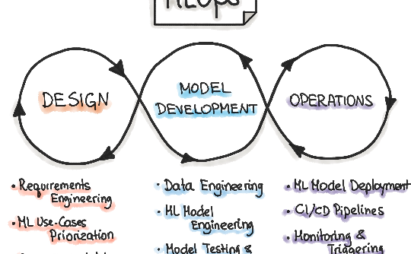

The AI Development Process
Data collection and preprocessing
Model development and training
Model evaluation and fine-tuning
Choose a model, train it on your data, and tune its hyperparameters to improve performance.
Understand your problem, identify data sources, and collect data that will help solve the problem.
Evaluate your model's performance and fine-tune it to improve results.
Note: This process is iterative and can take a long time to complete.

Slide 5
Ethical Considerations in AI
1
Privacy
Protecting personal information from unwanted access or disclosure.
Bias and Discrimination
2
Eliminating unfair treatment of individuals or groups due to their race, gender, socioeconomic background, etc.
3
Transparency and Explainability
Maintaining transparency and explainability in AI systems to ensure that humans can understand how decisions are being made.

Slide 6
Applications of Artificial Intelligence
Healthcare
Finance
Transportation
AI can help diagnose diseases and develop personalized treatments, improve patient outcomes and reduce medical errors.
AI can detect fraudulent transactions, perform risk analysis and prediction, and automate customer service.
AI can enable self-driving cars, optimize transportation routes, and improve traffic flow.

Slide 7

The Future of Artificial Intelligence
1
Improved Efficiency
2
Disruption
AI will drive technological improvements for many industries, making them faster and more efficient.
AI will transform industries, creating winners and losers. Companies that don’t adopt AI will likely fall behind.
3
New Jobs
While AI may eliminate some jobs, it will also create new ones, especially in fields related to programming, data analysis, and AI development.

Slide 8
Benefits of Artificial Intelligence
Improved decision-making
Increased efficiency and productivity
Cost savings
AI can reduce errors, waste, and unnecessary costs, generating significant savings for businesses and individuals.
AI can analyze vast amounts of data and patterns to support better decision-making.
AI can automate repetitive or time-consuming tasks, freeing up time and resources.

Slide 9
Challenges of Artificial Intelligence
1
Data bias and quality
AI algorithms can produce biased or incorrect results if trained on incomplete or biased data.
Regulations and Ethics
2
As AI becomes more ubiquitous, policymakers and industry leaders must grapple with issues around privacy, safety, and liability.
3
Acceptance and Trust
For many people, AI is still a novel concept that is misunderstood or mistrusted.

Slide 10
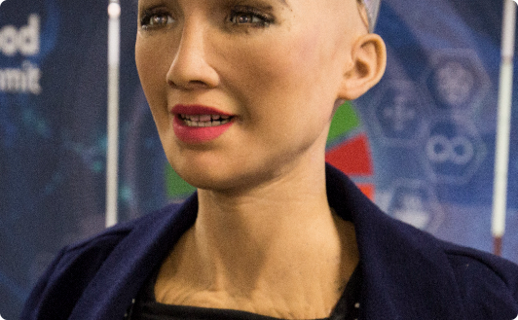
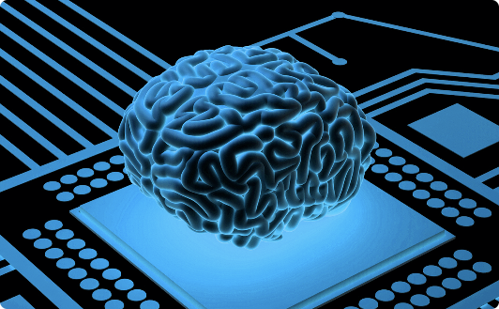

AI's Impact on Society and the Future
Workforce Displacement
Human Augmentation
Artificial Creativity
AI will replace some jobs and reduce the need for human labor, leading to economic upheaval and the need for new social safety nets.
AI may enable new technologies that enhance human capabilities, like brain-computer interfaces and advanced prosthetics.
AI-generated art and music are already gaining prominence, raising new questions about the nature of creativity and artistic expression.

Slide 11

Conclusion
Artificial intelligence has come a long way in a short time and its potential is nearly limitless. But we must also think critically about its impact on society, the challenges it poses, and the ethical considerations that must be addressed along the way. By staying informed and proactive, we can help shape the future of AI and ensure that it works for the benefit of all.

